Slide 1
Dimensionality Reduction and Feature Selection

Slide 2
Dimensionality reduction
In machine learning classification problems, there are often too many factors on the basis of which the final classification is done.
These factors are basically variables called features.
The higher the number of features, the harder it gets to visualize the training set and then work on it.
Sometimes, most of these features are correlated, and hence redundant.
Dimensionality reduction is the process of reducing the number of random variables under consideration, by obtaining a set of principal variables.

Slide 3
Dimensionality reduction
Example
Email: Spam or not Spam
Features: whether or not the e-mail has a generic title, the content of the e-mail, whether the e-mail uses a template, etc.
Classification:
Dataset Features: Temperature, Humidity, Rainfall etc..
Dimensionality reduction can be divided into:
Feature selection :
Find a subset of the original set of variables, or features, to get a smaller subset which can be used to model the problem.
Feature extraction/scaling:
This reduces the data in a high dimensional space to a lower dimension space, i.e. a space with lesser no. of dimensions.

Slide 4
Feature Selection
Higher dimensional data sets increase the time complexity and also the space required will be more.
Also, all the features in the dataset might not be useful.
Some may contribute no information at all, while some may contribute similar information as the other features.
Selecting the optimal set of features will help us hence reduce the space and time complexity as well as increase the accuracy or purity of classification (or regression) and clustering (or association) for supervised and unsupervised learning respectively.

Slide 5
Feature Selection
Also called Variable Selection and Attribute Selection.
Task of selecting a subset of relevant features for use in model construction
It is used to identify and remove unneeded, irrelevant and redundant attributes from data.
It has Four approaches
Wrapper method
Filter Method
Embedded Method
Hybrid Method

Slide 6
Feature Selection Approaches
Wrapper method
It considers the selection of a set of features as a search problem, where different combinations are prepared, evaluated and compared to other combinations.
A predictive model is used to evaluate a combination of features and assign a score based on model accuracy.
Eg: Best Fit Search and Random Hill Climbing
Filter Method
Applies a statistical measure to assign a scoring to each feature.
Features are ranked by the score and either selected or rejected from the dataset.
Eg: Correlation Coefficient Scores, Chi Square Test

Slide 7
Feature Selection Approaches
Embedded method
The applied learning algorithms determine the specificity of this approach
It selects the features during the process of training the data set.
Hybrid Method
Both filter and wrapper-based methods are used in hybrid approach.
This approach first selects the possible optimal feature set which is further tested by the wrapper approach.
It hence uses the advantages of both filter and wrapper-based approach.

Slide 8
Parameters for Feature Selection
The parameters are classified based on two factors:
The Similarity of information contributed by the features :
Correlation
Quantum of information contributed by the features :
Entropy
Mutual Information

Slide 9
Parameters for Feature Selection
Correlation
Features may be correlated and may have some correlation factor.
If f1 and f2 are two correlated features of a data set, then the classifying or regression model including both f1 and f2 will give the same as the predictive model compared to the scenario where either f1 or f2 was included in the dataset.
This is because both f1 and f2 are correlated Only one representative can be considered
Method of finding Correlation: Pearson’s correlation coefficient(ρ)
where ,
cov(X, Y) - covariance
σ(X) - standard deviation of X
σ(Y) - standard deviation of Y

Slide 10
Parameters for Feature Selection
Entropy
It is the measure of the average information content.
The higher the entropy, the higher is the information contribution by that feature. Entropy (H) can be formulated as:
To calculate Entropy of feature fi: Exclude fi and calculate entropy for rest of the features.
If Entropy is low, then the information by feature fi is high.
Entropy is mostly used for Unsupervised Learning
Where, X - discrete random variable X
P(X) - probability mass function
E - expected value operator,
I - information content of X.
I(X) - a random variable.

Slide 11
Parameters for Feature Selection
Mutual Information
Amount of uncertainty in X due to the knowledge of Y.
It is calculated as:
where
p(x, y) - joint probability function of X and Y,
p(x) - marginal probability distribution function of X
p(y) - marginal probability distribution function of Y
Calculated to know the amount of information shared about the class by a feature.
Mostly used for dimensionality reduction in Supervised Learning

Slide 12
Feature Scaling
Feature Scaling is a technique to standardize the independent features present in the data in a fixed range.
It is performed during the data pre-processing.
Feature Scaling Algorithms will scale Age, Salary, BHK in fixed range say [-1, 1] or [0, 1].
And then no feature can dominate other.
If feature scaling is not done, then a machine learning algorithm tends to weigh greater values, higher and consider smaller values as the lower values, regardless of the unit of the values.

Slide 13
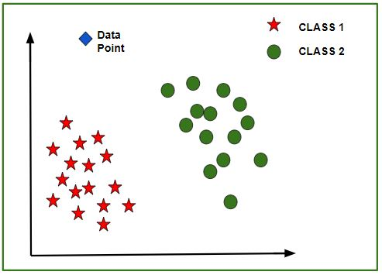
Without Feature Scaling
Eg: Classes: Yes or No
Prediction of the class of new data point:
The model calculates the distance of this data point from the centroid of each class group.
Finally this data point will belong to that class, which will have a minimum centroid distance from it.

Slide 14
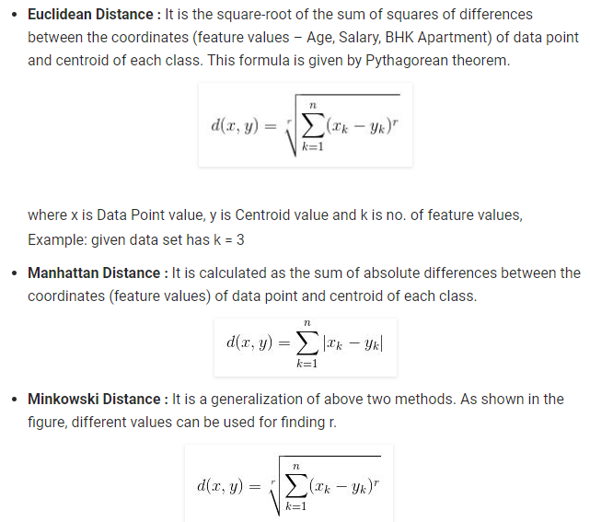
Without Feature Scaling: Distance Measure

Slide 15
Feature Scaling
Example:
If an algorithm is not using feature scaling method then it can consider the value 3000 meter to be greater than 5 km but that’s actually not true and in this case, the algorithm will give wrong predictions.
So, we use Feature Scaling to bring all values to same magnitudes and thus, tackle this issue.

Slide 16
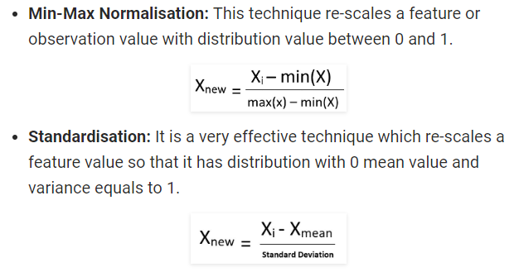
Techniques for Feature Scaling

Slide 17
Methods of Dimensionality Reduction
Dimensionality reduction may be both linear or non-linear, depending upon the method used.
The various methods used for dimensionality reduction include:
Principal Component Analysis (PCA)
Linear Discriminant Analysis (LDA)
Generalized Discriminant Analysis (GDA)
Most Common Linear Method:
Principal Component Analysis (PCA)

Slide 18
Principle Component Analysis
This method was introduced by Karl Pearson.
Principal Component Analysis (PCA) is a dimension-reduction tool that can be used to reduce a large set of variables to a small set that still contains most of the information in the large set.
It is a mathematical procedure that transforms a number of (possibly) correlated variables into a (smaller) number of uncorrelated variables called principal components.
The first principal component accounts for as much of the variability in the data as possible, and each succeeding component accounts for as much of the remaining variability as possible.

Slide 19
PCA Implementation
Step 1: Normalize the data
Eg: Try to produces a dataset whose mean is zero
Step 2: Calculate the covariance matrix
Step 3: Calculate the eigenvalues and eigenvectors
Step 4: Choosing components and forming a feature vector:
Order the eigenvalues from largest to smallest and select n principle components from the top
Form a Feature Vector: only those eigenvectors which will be considered
Step 5: Forming Principal Components:
NewData = FeatureVector^{T} x ScaledData^{T}
NewData = Matrix consisting of the principal components
 | x | y
x | Cov(x,x) | Cov(x,y)
y | Cov(y,x) | Cov(y,y)

Slide 20
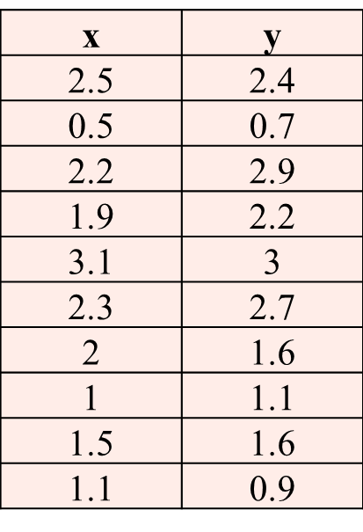
PCA Example
Step 1: Fine the mean Values
Data: Mean Values:
x' = 1.81
y' = 1.91

Slide 21
PCA Example
Step 2: Subtract the mean to make the data pass through the origin.
The normalized data will have mean=0
Step 3: Find the Co-Variance Matrix: It shows how two variable vary together
(x’-x) | (y’-y)
-0.69 | -0.49
1.31 | 1.21
-0.39 | -0.99
-0.09 | -0.29
-1.29 | -1.09
-0.49 | -0.79
-0.19 | 0.31
0.81 | 0.81
0.31 | 0.31
0.71 | 1.01

Slide 22
PCA Example
The Co-variance matrix for example is:
Since, the non-diagonal elements in covariance matrix are positive, Thus, x and y variable increase together in one direction.
Step 4: Calculate Eigen Vales and Eigen Vectors for covariance matrix”
The most important (principle) Eigen vector would have the direction in which the variables strongly correlate.

Slide 23
PCA Example
Step 5: The Eigen vectors with highest Eigen value will be selected for PCA.
Now we can ignore the other dimensions,
For n dimensions of data→ n Eigen vectors→ select p Eigen vectors
For dimensionality reduction p < n
Final data= FeatureVector^{T} x ScaledData^{T}
Final data is the final dataset, with data items in columns, and dimensions along rows.
Example data has 2 dimensions so data was in terms of x and y. Now the data will be in the terms of eigen vectors.

Slide 24
Pros and cons of Dimensionality Reduction
Advantages of Dimensionality Reduction
It helps in data compression, and hence reduced storage space.
It reduces computation time.
It also helps remove redundant features, if any.
Disadvantages of Dimensionality Reduction
It may lead to some amount of data loss.
PCA tends to find linear correlations between variables, which is sometimes undesirable.
PCA fails in cases where mean and covariance are not enough to define datasets.
We may not know how many principal components to keep- in practice, some thumb rules are applied.

